Slide 1
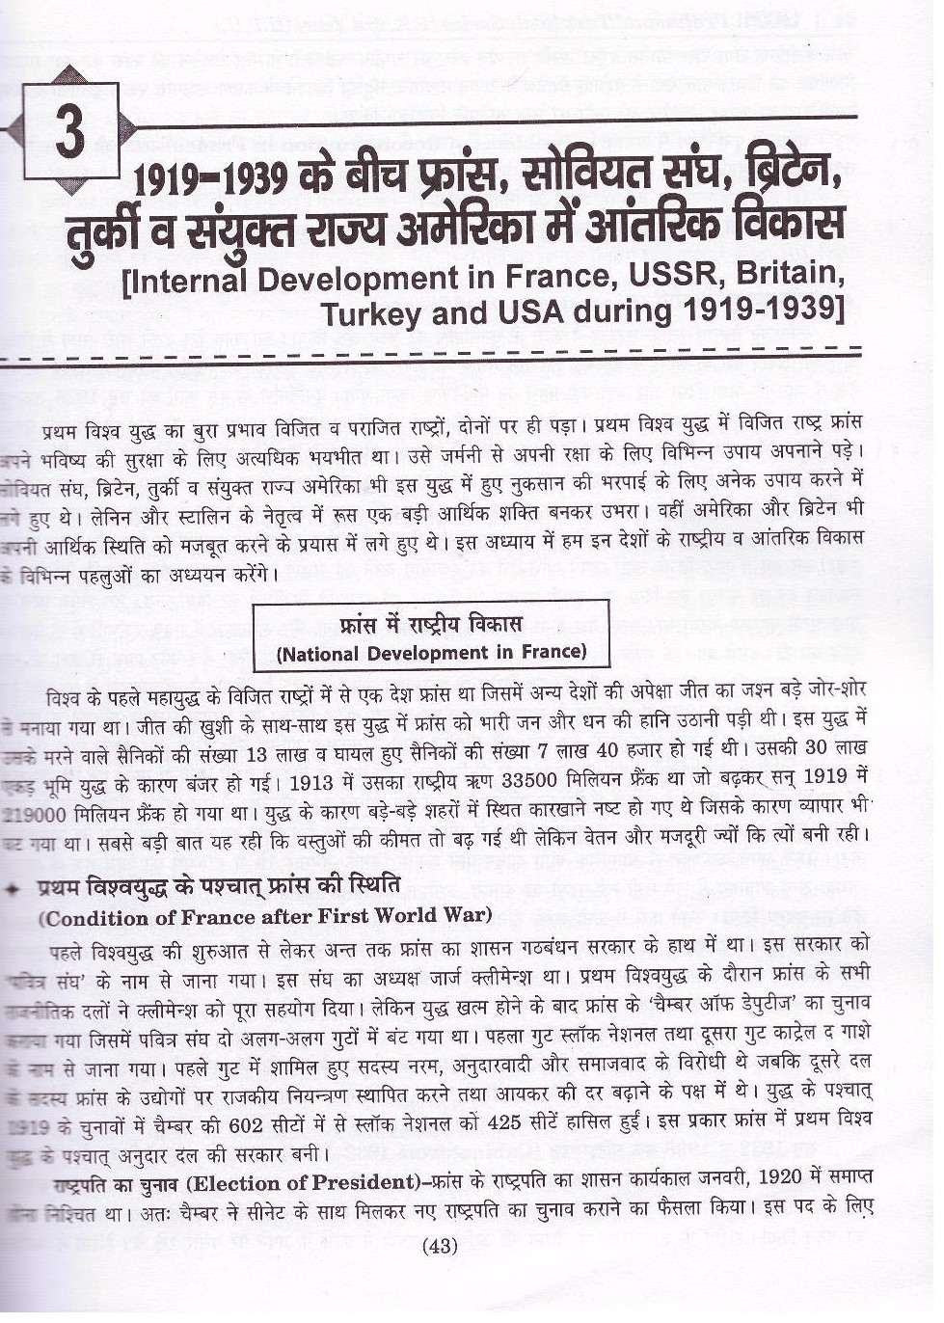
Internal Development in France, USSR, Britain, Turkey and USA during the 1919-1939

Slide 2
National development in France

Slide 3
Condition of France after first world war

Slide 4
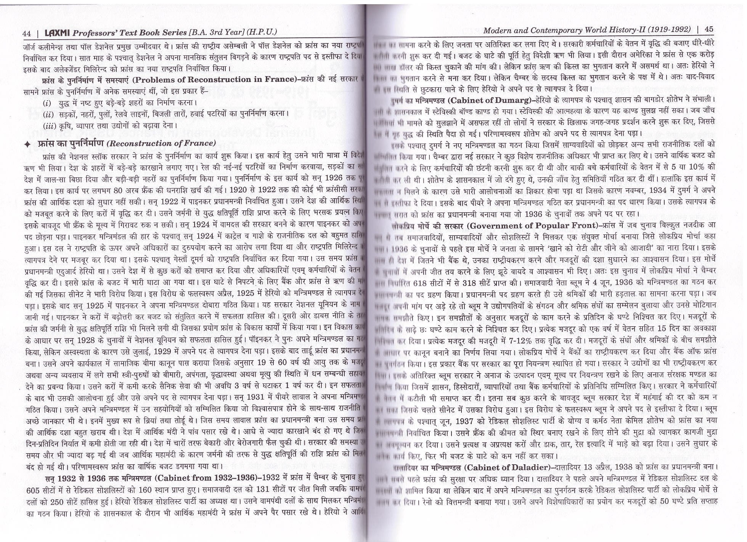

Slide 8
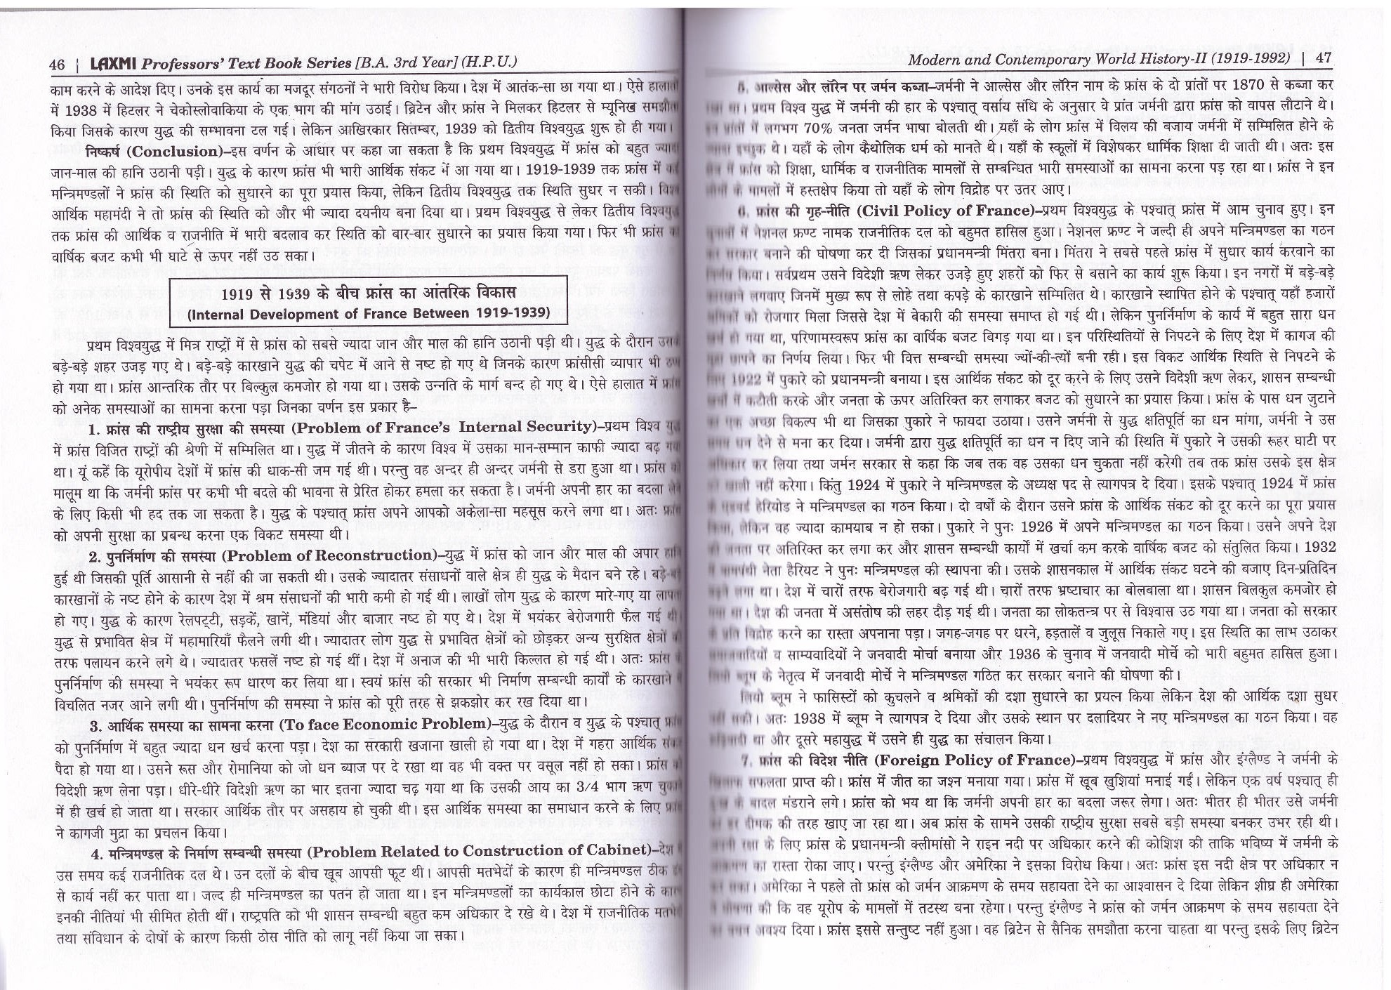

Slide 9
Internal development of France between 1919-1939

Slide 11
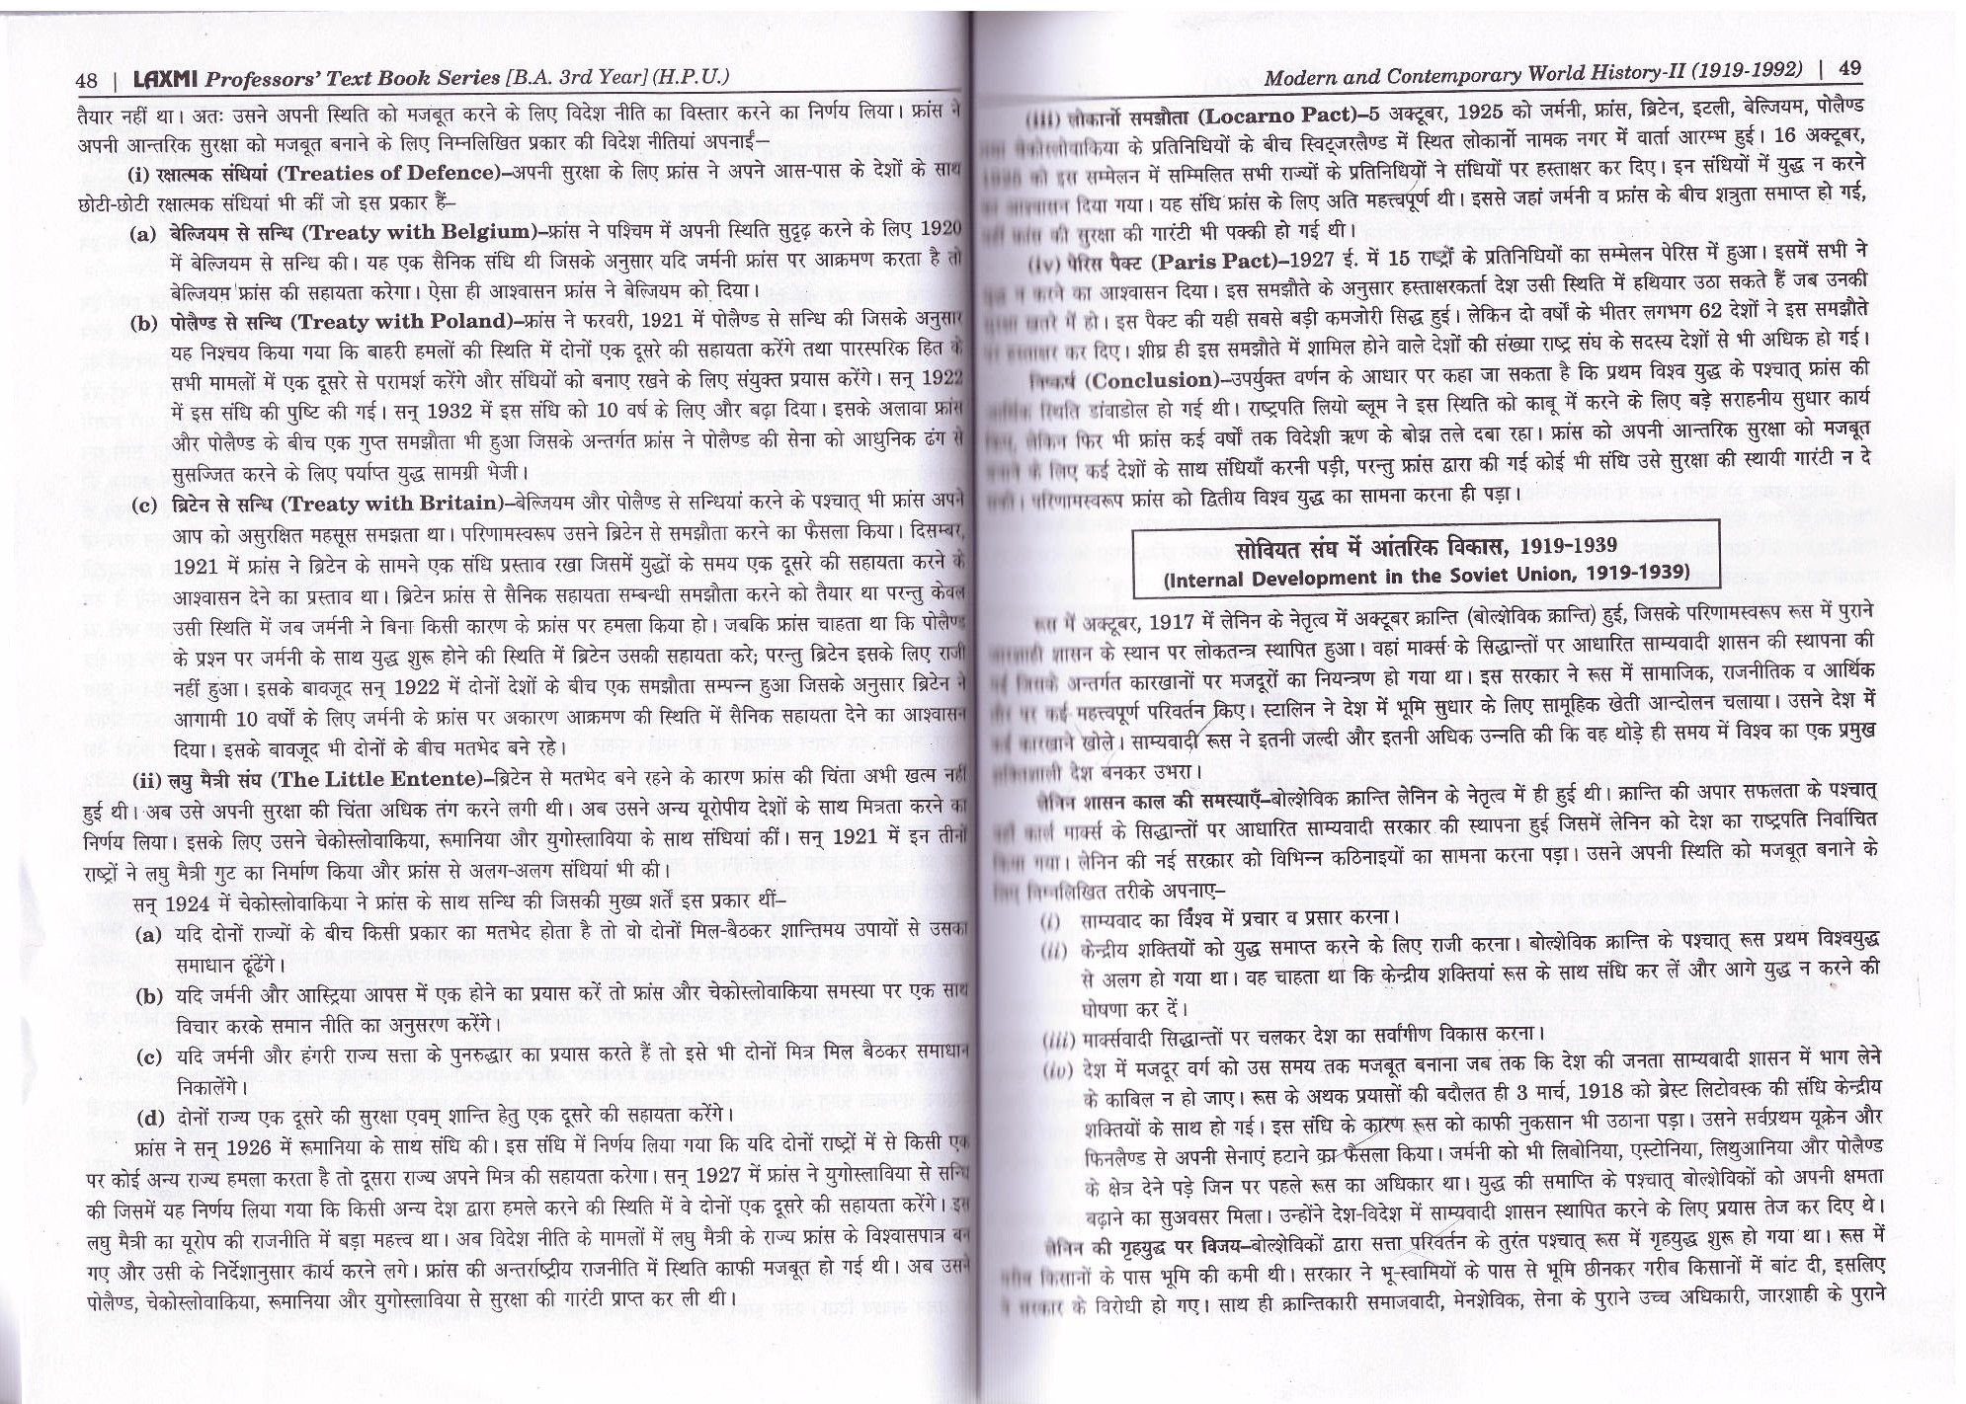

Slide 14
Internal development of soviet union

Slide 15
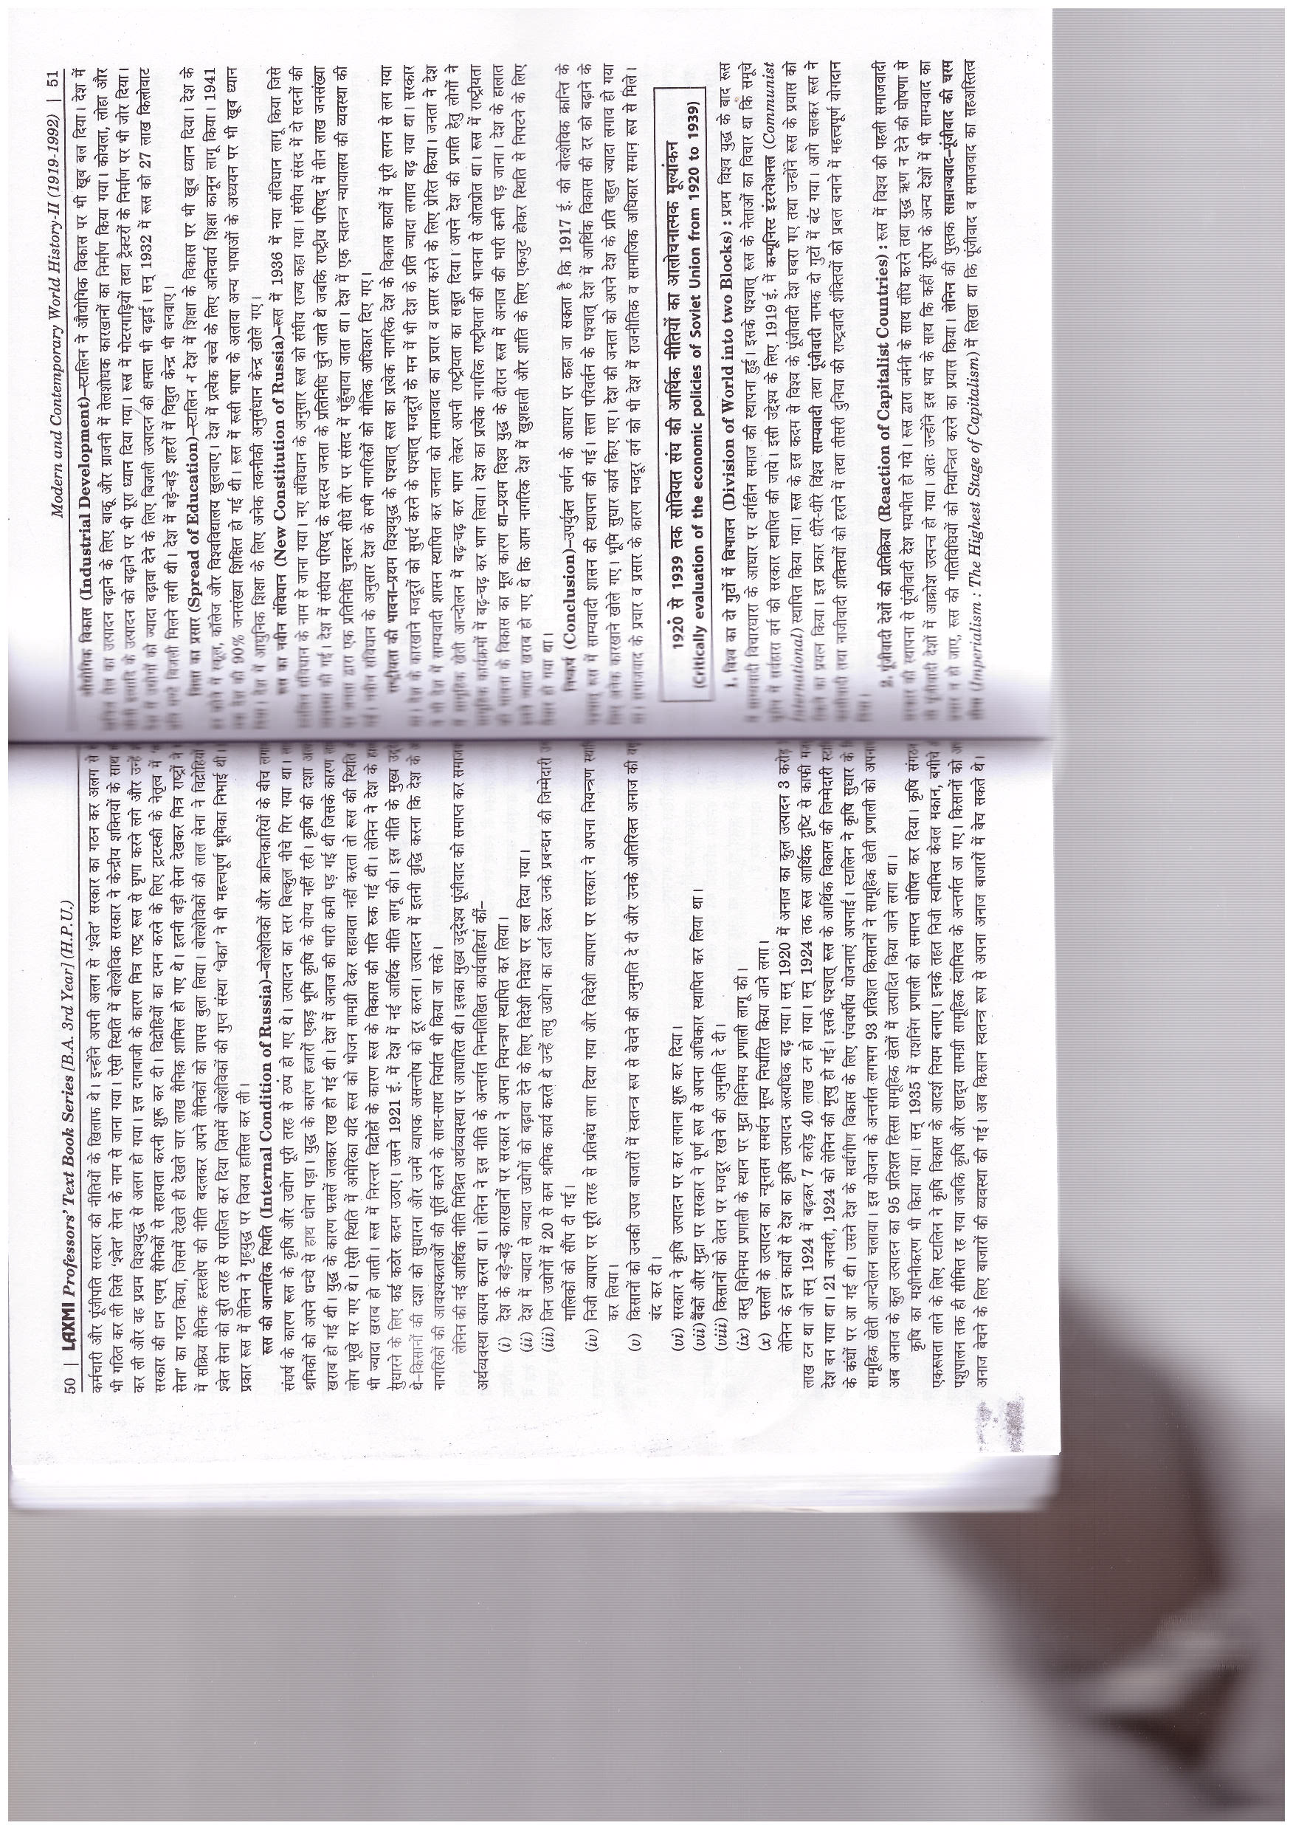

Slide 17
Critically evaluation of the economics policies of soviet union from 1920 to 1939

Slide 18
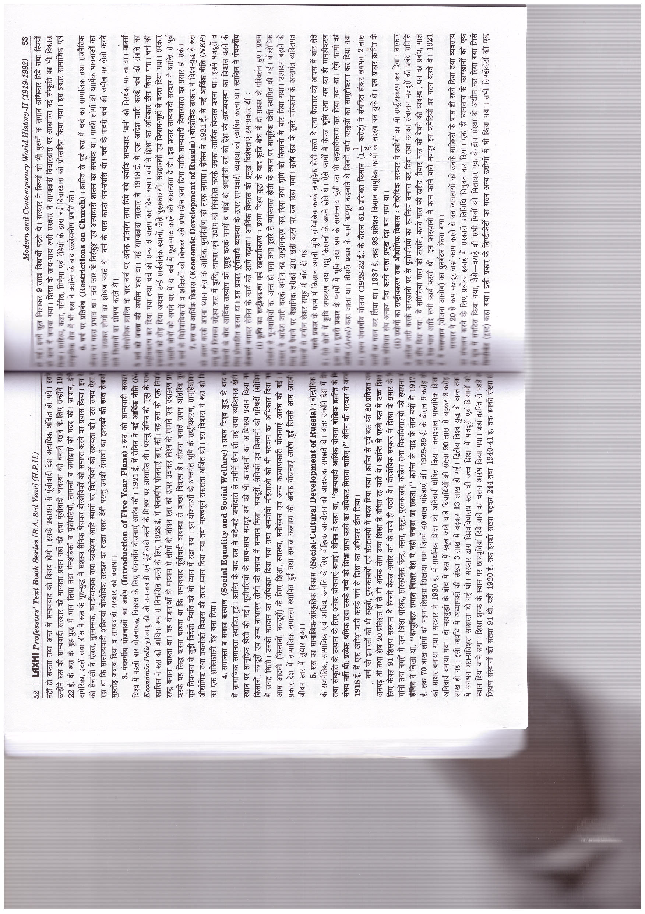

Slide 22
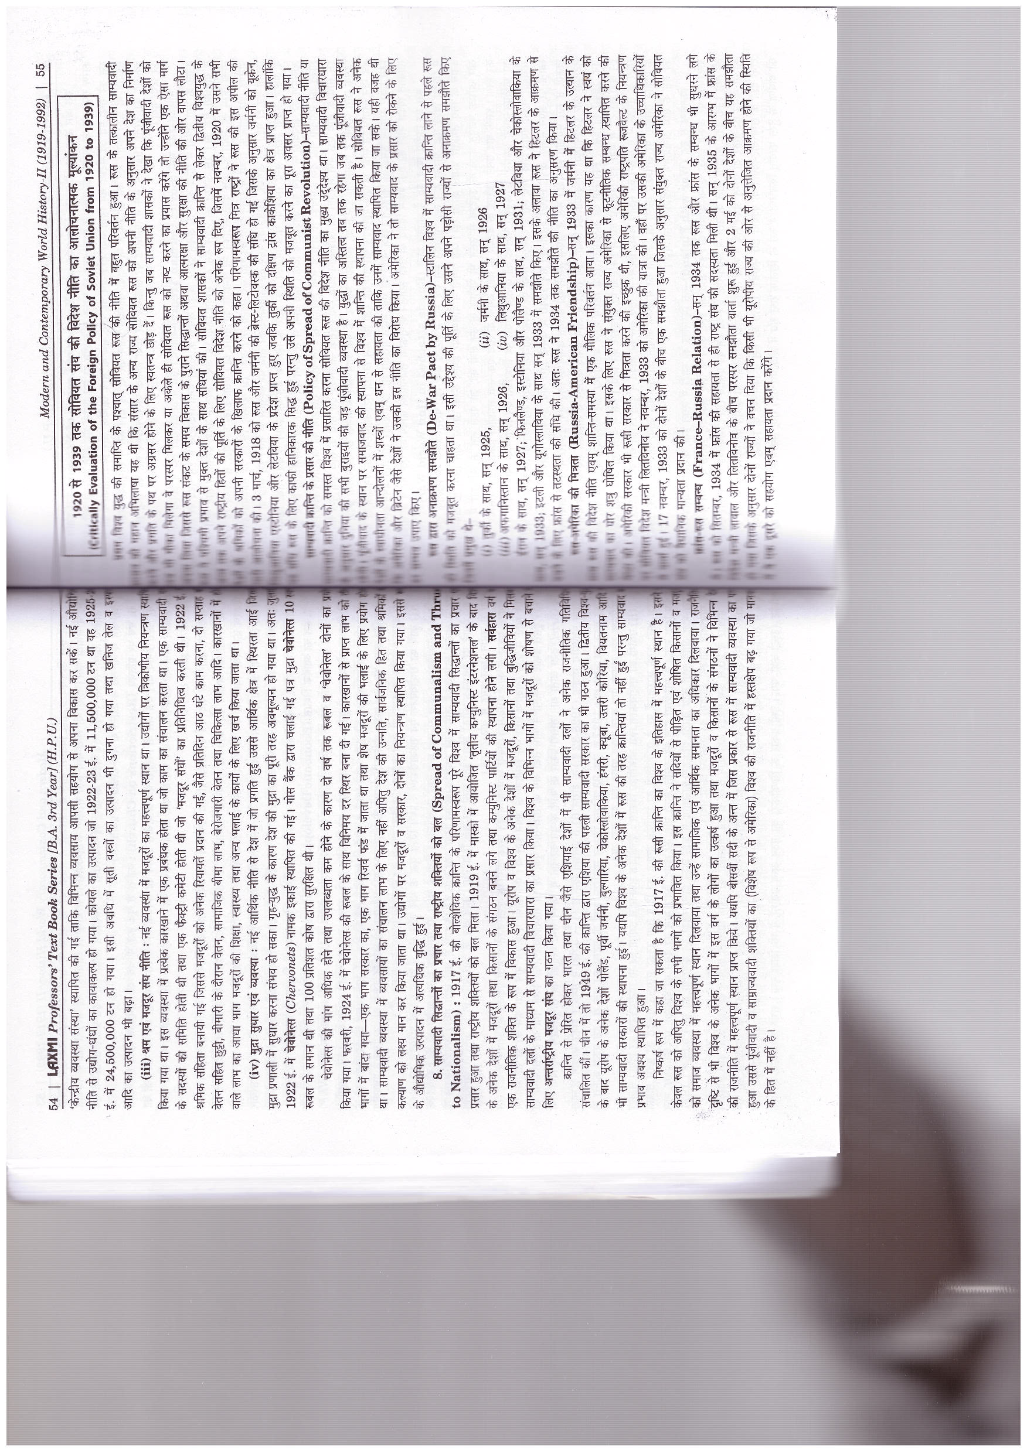

Slide 23
Crtically evaluation of the foreign policy of soviet union from 1920 to 1939

Slide 25
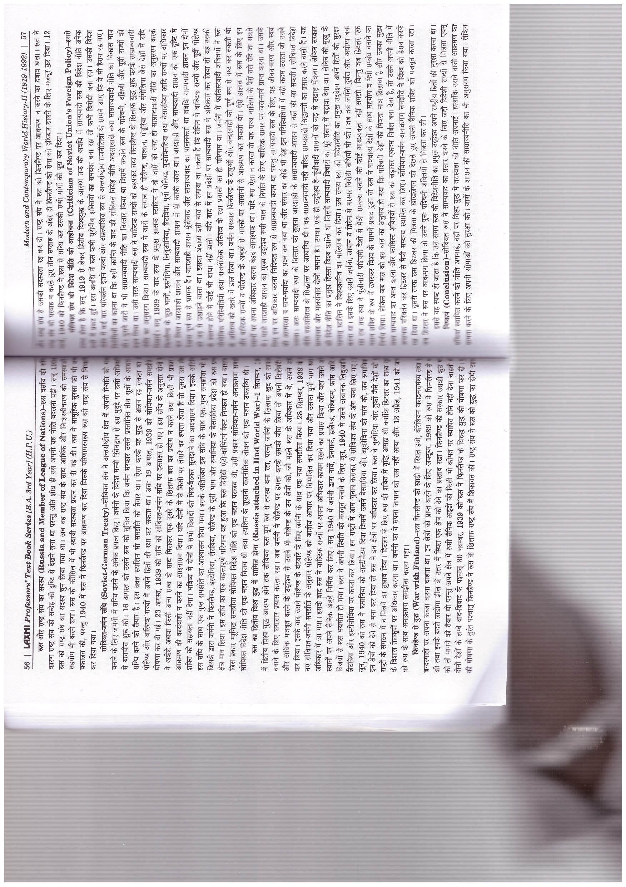

Slide 27
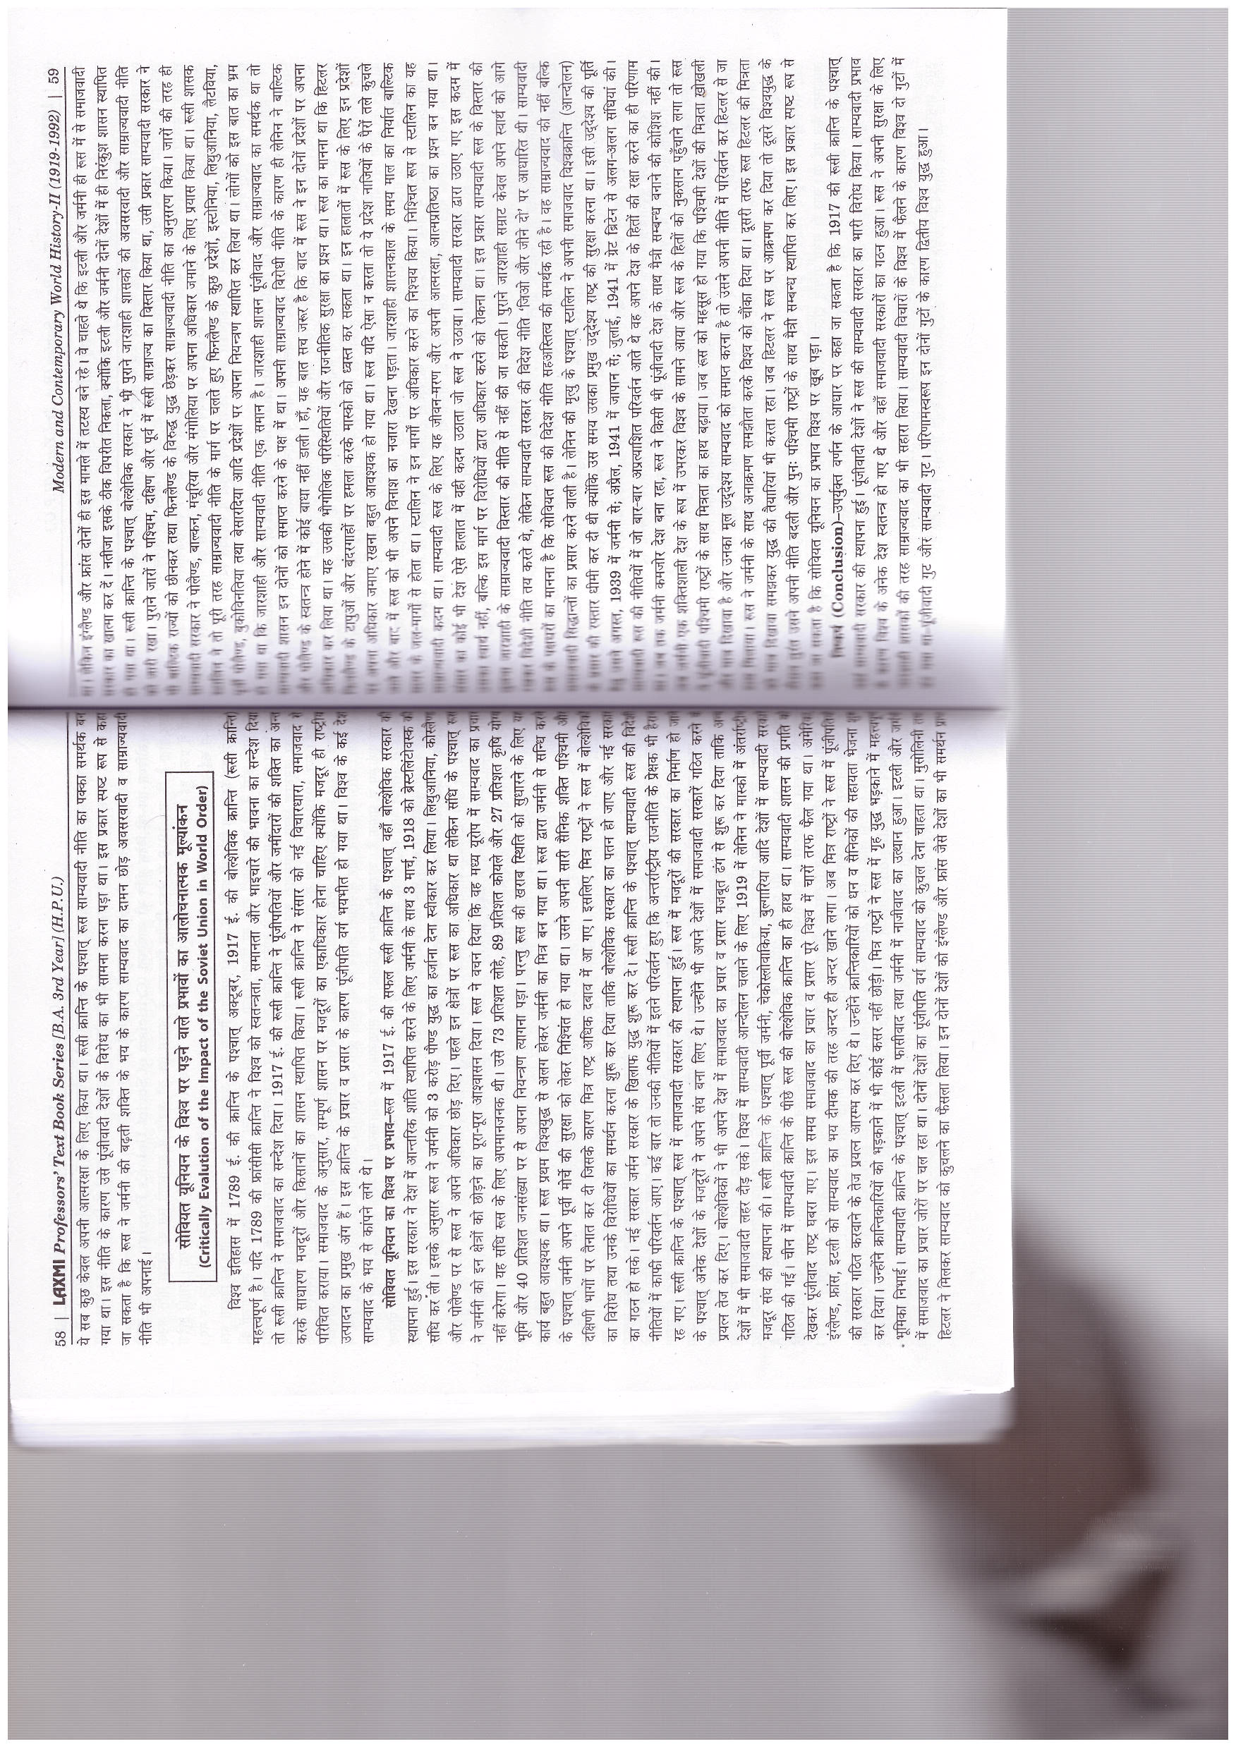

Slide 28

Critically evalution of the impact of the soviet union in world order

Slide 30
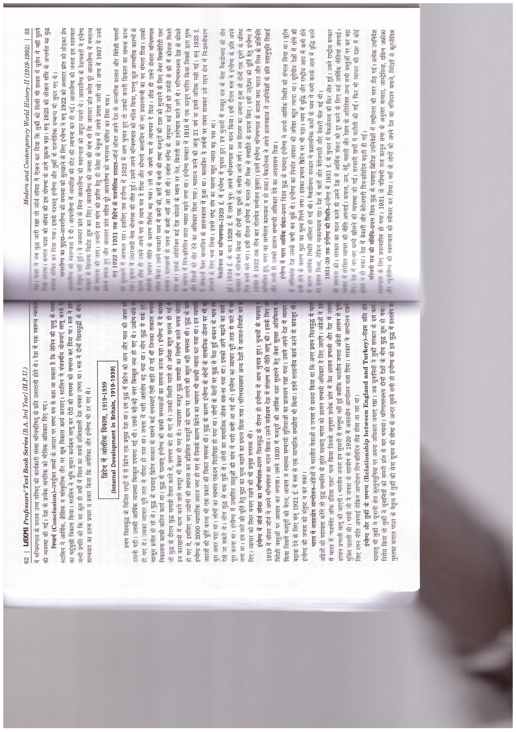

Slide 31
Internal Development in Britain

Slide 33
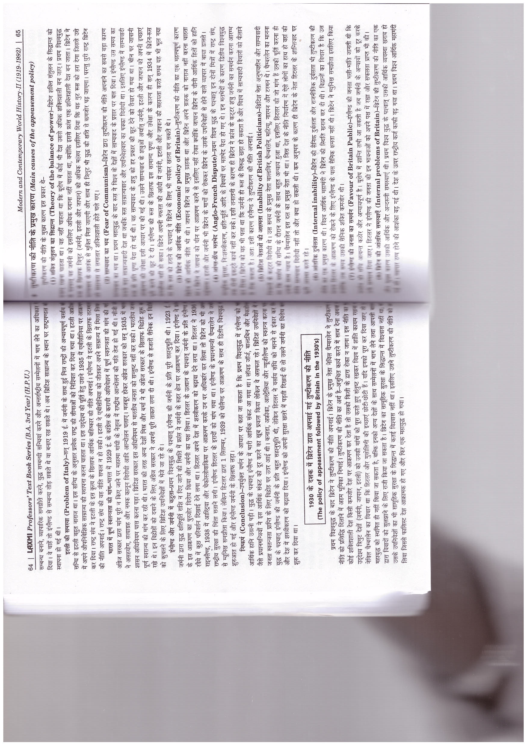

Slide 34
The policy of appeasement followed by Britain in the 1930’s

Slide 35
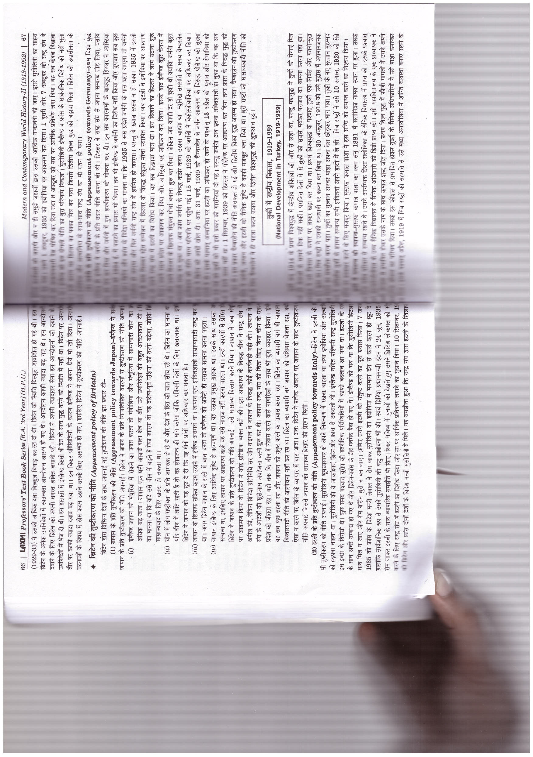

Slide 37
National Development in Turkey 1919-1939

Slide 38
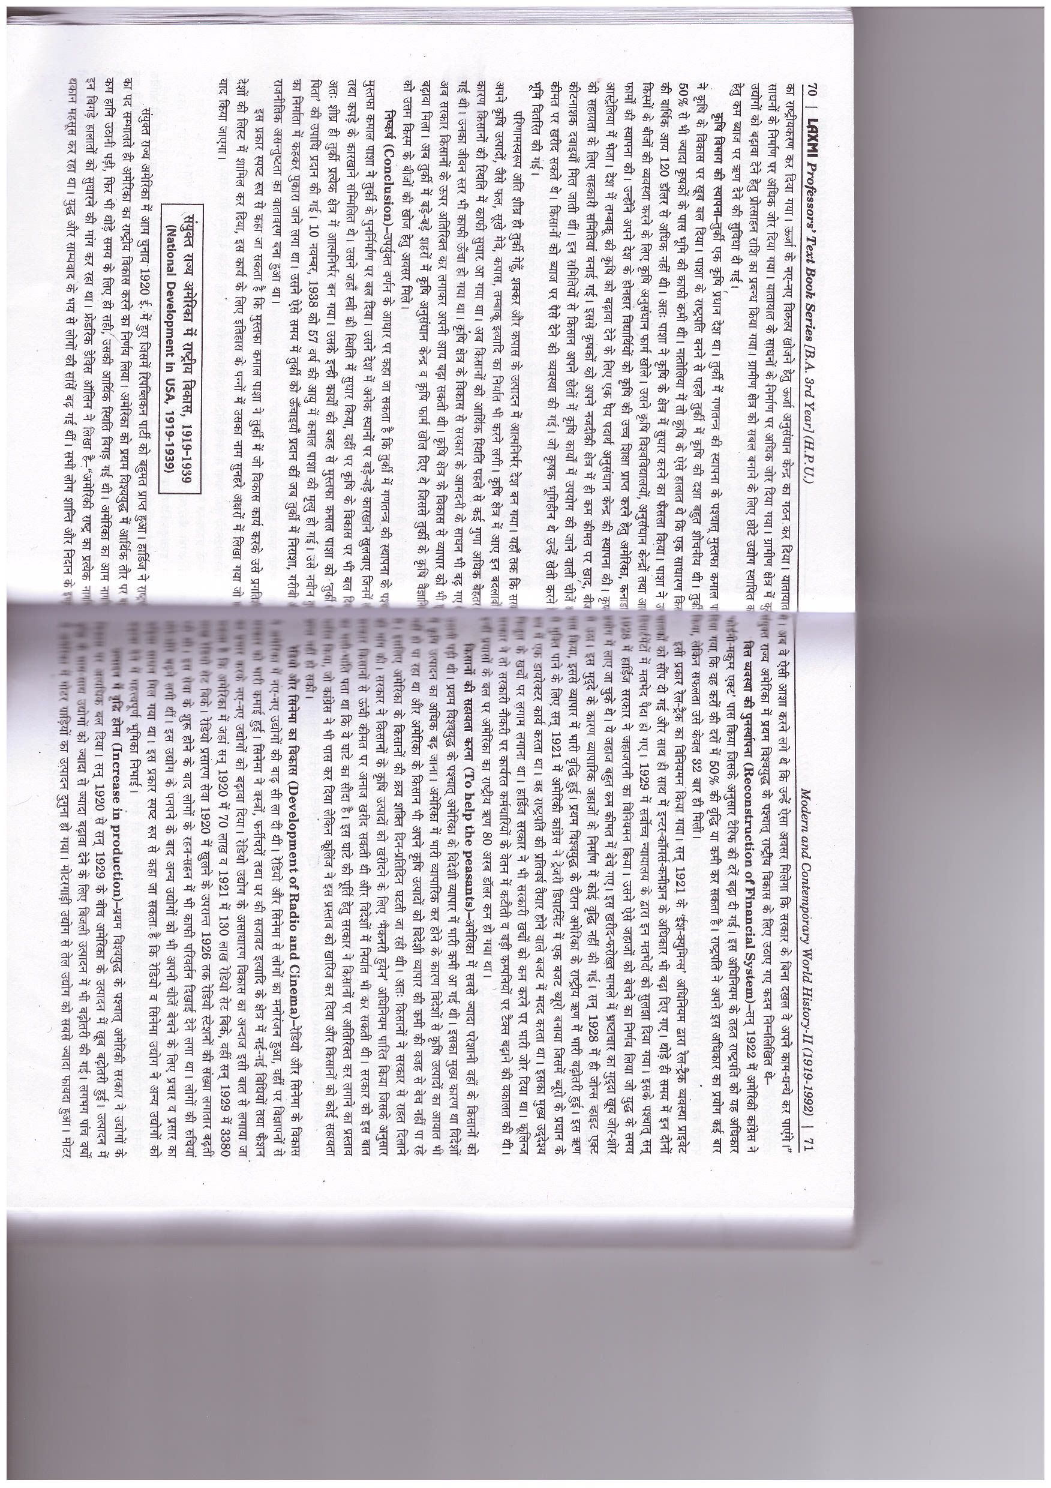

Slide 39
NATIONAL DEVELOPMENT IN USA

Slide 41
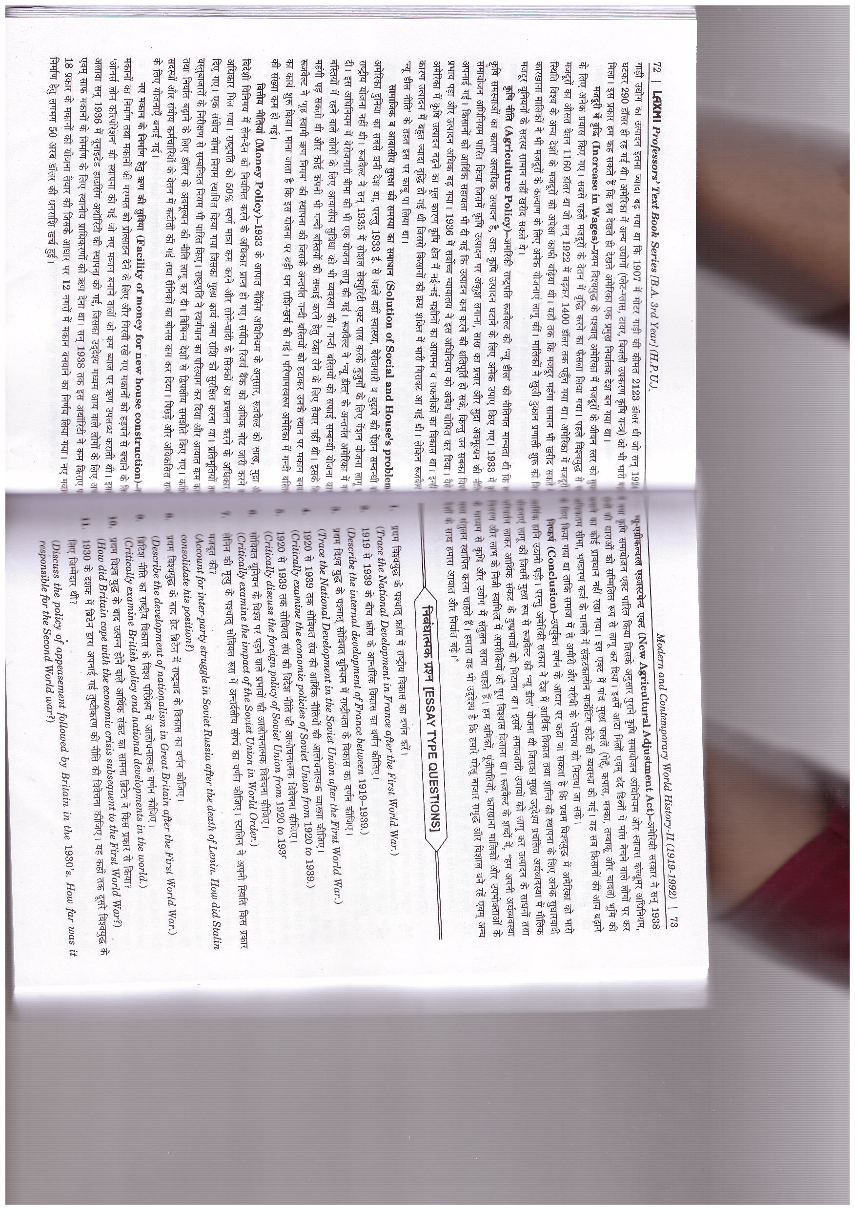

Slide 42
vvvvvv

